Slide 1
Open Flow
Supernova 2008
June 17, 2008

Slide 2
Proprietary Software
World Wide Web
Closed
Open
Wikipedia
Never Shared
Open Source

Slide 3
…openness is not binary; information or processes are not open or closed. They sit on a broad continuum stretching from closed to open, based on their accessibility and responsiveness…

Slide 4
…if information is not available or available only under restrictive conditions it is less accessible and therefore less “open.”

Slide 5
…if information can be modified, repurposed, and redistributed freely it is more responsive, and therefore more “open.”

Slide 6

…but greater openness is not always the best solution…

Slide 7
Privacy, security, protecting the rights of creators, fostering competition, are among values that might limit openness
Or might not. Security via obfuscation? Protect the perimeter or protect the core?
The purpose and context are critical

Slide 8
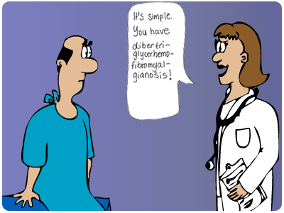
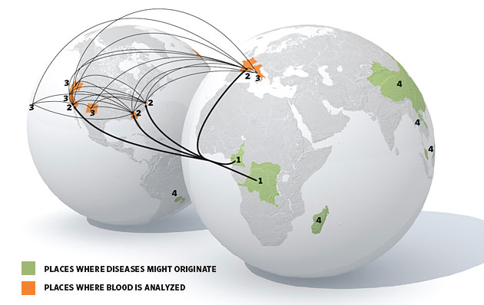
…openness is ultimately not about technology but about an attitude…
…greater openness is when patients have more information and doctors listen closely to them…
…when game hunters in Cameroon provide samples to public health researchers on the lookout for emerging diseases…

Slide 9
Openness and Value Creation I
The traditional theory of Intellectual Property sees control as central to value creation and, therefore, innovation
Providing control to the creator (or the rights holder) allows the innovation to be monetized through licensing etc.
The greater the control (longer terms, higher penalties for infringement) the greater the incentive for innovation
But access control is costly and never perfect

Slide 10
Openness and Value Creation II
Creating value from sharing offers a mirror image to the traditional view of IP and control
The wider the sharing, the greater the openness, the more potential value from both expected and unexpected sources
Modifying, copying, and distributing are cheap
With enough eyeballs, all bugs are shallow

Slide 11
Information wants to be free
Information wants to be expensive

Slide 12
Products of Increased Openness
Wikipedia
Public Library of Science (PLoS)
YouTube and user-generated content of all kinds
Collaborative filtering
Mash-ups and Remixes
Craigslist
Open innovation e.g. P&G—From “not invented here” to “proudly discovered elsewhere” (Or is this just outsourcing R&D? Who gets the value?)
Tinkering and other user-led innovation
Reporting of all clinical trials, even failures

Slide 13
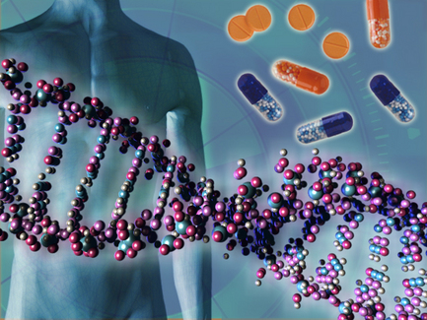
The Human Genome Project: A Model of…
openness
openness
openness
openness
openness
openness
openness
openness
openness
openness
openness
openness
openness
openness

Slide 14
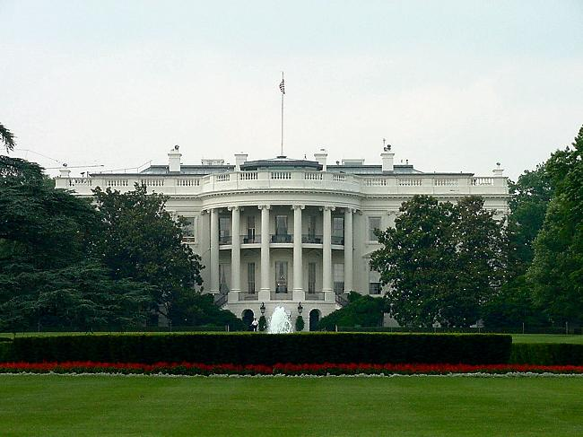

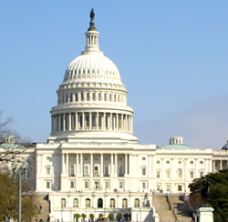
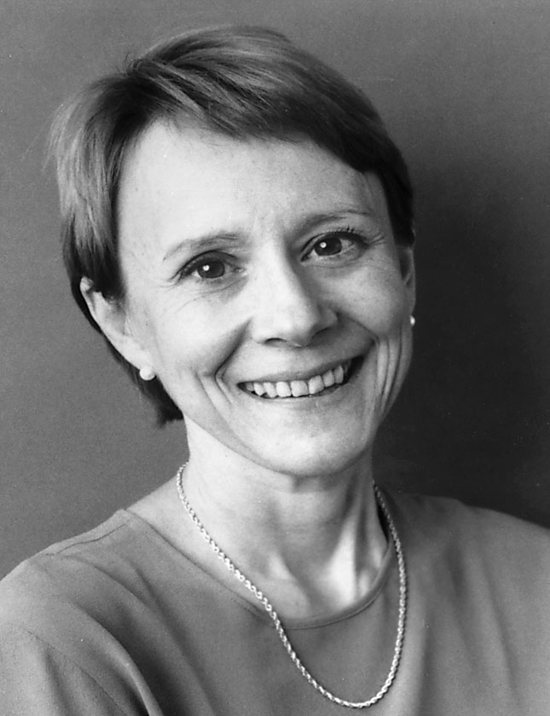
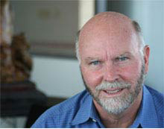
What Happens To Genomic Data?
Legislation forbidding discrimination based on genetic information was just enacted
Some prominent individuals have already made their genetic profiles public…

Slide 15
Standards
Standards
Standards
Standards
Standards
Standards
Standards
…greater openness is impossible without standards…
…open standards reflect increased openness…

Slide 16
…only
1/4
of medical practices are based on adequate evidence of their efficacy…

Slide 17
…most drugs prescribed have positive impacts on fewer than
60 percent
of those receiving them…

Slide 18
…according to the Agency for Healthcare and Quality Research and the National Cancer Institute, it takes
13-17 years
to get
14 percent
of research into healthcare practice…

Slide 19
52 percent
…of primary care physicians report that their patients are now arriving with printouts from web searches…

Slide 20
25 percent
…roughly
of U.S. doctors utilize EHRs
Compared to:
98 percent of doctors in the Netherlands
92 percent of doctors in New Zealand
89 percent of doctors in the UK…

Slide 21
Genomic, nutrigenomic,
pharmacogenomic, epigenomic, and proteonomic data
Environmental exposure
Evidence
Based
Data underlying clinical trials and research sponsored by government-funded agencies
Insurance claims data
Medicine
Family medical history
Deidentification
Diet and exercise data

Slide 22
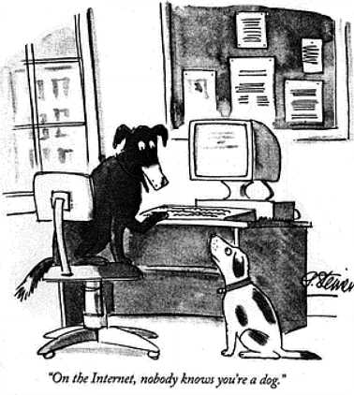
…on the internet, everyone knows you’re a dog…

Slide 23
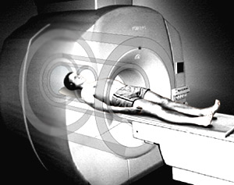
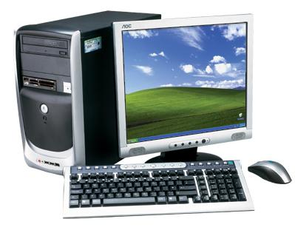
Regulatory concerns over post-approval changes to medical devices
user driven innovation in computational devices

Slide 24
Privacy/Security
Evidenced-based medicine
Electronic Health Records
Standards, terminology and nomenclature that allow the sharing and manipulation of data
Biomedical Research
Clinical Trials Data
Present Data Disclosure
Access to underlying data in searchable and computable form
Traditional publishing methods
Open Access Journals and Repositories
Concerns over post-approval changes
User driven innovation in computational devices
Medical Devices

Slide 25
For further information, contact emaxwell@emaxwell.net, or visit http://www.emaxwell.net
*Images used under a Creative Commons license

